Slide 1
Protein and Amino acid Metabolism

Slide 2
Biological importance
Body proteins have life times. They undergo degradation and re-synthesis. about 6 gm of protein is synthesized and broken down per kg body weight per day.
Aged proteins, damaged or modified proteins and non-functional proteins of the body undergo degradation(i.e enzyme control)-quality control mechanism.
Protein degradation play an important role in shaping tissues and organs during pregnancy and development.
Protein synthesis and degradation is an integral part of cellular adaptation to changed environment.
Amino acids are needed for the formation of specialized products like: hormones, purines, pyrimidines, porphyrins, vitamins, amines, creatine and glutathione.

Slide 3
Protein turn over
Like intermediates of metabolic pathways body proteins are in dynamic state.
Continuous synthesis and degradation of protein is known as protein turnover.
Note: The rates of protein synthesis and degradation vary according to physiological needs.
The rate of protein synthesis: high during growth, lactation and post operative recovery.
The rate of protein degradation: high In starvation, cancer, fever and during morphogenesis.

Slide 4
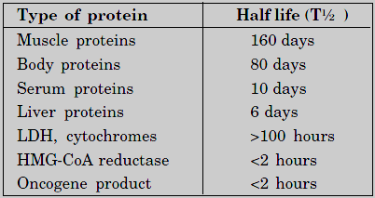
Protein half life
Body proteins have life times which are expressed in terms of half-life.
Half life of proteins ranges from minutes to years and may be increased or decreased depending on call needs.

Slide 5
Signals for protein breakdown
It is not clear what triggers or initiates protein degradation.
However, some structural features of proteins which serve as signals for their degradation have been identified.
Ubiquitinization
Ubiquitin is a small protein present in eukaryotes.
Ubiquitin attachment to a protein serve as signal for degradation of that protein.
PEST sequences
PEST sequence proline (P), glutamate (E), serine (S) and threonine (T) rich region of a protein serves as mark for the degradation of the protein.
N-terminal amino acids
Presence of amino acids like arginine or lysine, phenyl alanine and aspartate at amino terminal serve as signal for degradation of the protein.
Oxidized amino acids
If a protein contains an oxidized amino acid then it undergoes degradation because oxidized amino acid is recognized by protein degrading enzymes.

Slide 6
Enzymes of protein degradation
Protease and peptidases
Several intracellular proteases and peptidases are involved in protein degradation. Proteases like tryptase, chymase, elastase, collagenase and calpains hydrolyzes proteins forming oligo peptides.
Peptidases further degrade oligo peptides to dipeptides.
Finally aminoacids are formed by the action of dipeptidases on dipeptides.
Cathepsins
They are hydrolytic enzymes present in lysosomes. They are responsible for the degradation of glycoprotein hormones and other intracellular proteins.
Megapain
It is a high molecular mass protease present in liver and skeletal muscle. It degrades proteins in presence of ubiquitin.
Multicatalytic proteases (Proteosome)
They pocess multicatalytic function and are present in the cytosol of most of mammalian cells.

Slide 7
Amino acid pool
Amino acid pool is the amount of free amino acids distributed throughout the body.
Blood plasma contains most of the 20 amino acids, however the concentrations of individual amino acids in blood are different (e.g. There are very high con’c of glutamate and alanine and very low con’c of aspartate)
Amino acids in plasma are rapidly taken up by tissues, therefore the average half life of a plasma amino acid is about 5 minutes.
Sources of amino acid pool
1. Dietary proteins.
2. Breakdown of tissue proteins.
3. Biosynthesis of non-essential amino acids.

Slide 8
Fate of Amino Acids
1. Biosynthesis of structural proteins e.g tissue proteins
2. Biosynthesis of functional proteins e.g Haemoglobin , myoglobin, protein hormones and enzymes
3. Biosynthesis of small peptides of biological importance e.g glutathione, endorphins and enkephalins.
4. Biosynthesis of non protein nitrogenous compounds (NPN) such as urea, uric acid, creatine, creatinine, nucleotides and ammonia.
5. Catabolism to ammonia and α-keto acids.

Slide 9
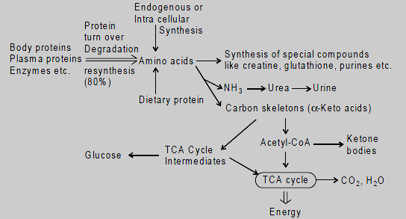
Sources and metabolic fates of amino acids

Slide 10
Amino acid catabolism
In the adult human body, only 20% of amino acids formed from protein degradation are catabolised to generate energy.
The remaining 80% amino acids are used for protein biosynthesis.
Excessive amino acids consumed from diet are also used for energy production because amino acids can not be stored in the body.
Amino acid catabolism occurs in two main stages.
Removal of amino group of amino acids as ammonia which is converted to urea and excreted in urine.
Conversion of the carbon skeletons of amino acids into intermediates of TCA cycle and acetyl-CoA.

Slide 11
Metabolic Circumstances of Amino Acid Catabolism
In animals, amino acids undergo oxidative degradation in three different metabolic circumstances:
1. During the normal synthesis and degradation of cellular proteins (protein turn over)
2. In high protein diet, the ingested amino acids exceed the body’s needs for protein synthesis, the surplus is catabolized (amino acids cannot be stored).
3. During starvation or in uncontrolled diabetes mellitus, when carbohydrates are either unavailable or not properly utilized, cellular proteins are used as fuel.
Amino acids are transaminated to form α-keto acids, (carbon skeletons).
The α-keto acids undergo oxidation to CO₂ and H₂O to provide energy for brain, skeletal muscle, and other tissues or, provide three- and four-carbon units for gluconeogenesis,.

Slide 12
Metabolic Fates of Amino Groups
In the cytosol of hepatocytes, amino groups from most amino acids are transferred to α-ketoglutarate to form glutamate, which enters mitochondria and gives up its amino group to
form NH₄⁺
Excess ammonia generated in other tissues is converted to the amide nitrogen of glutamine, which enters the mitochondria → urea cycle.
In skeletal muscle, excess amino groups are generally transferred to pyruvate to form alanine.

Slide 13
Deamination of amino acids
This involves the first stage of amino acid catabolism.
There are several ways for the removal of α-amino group of amino acids.
Transamination followed by oxidative deamination (transdeamination).
Oxidative deamination.
Non-oxidative deamination.

Slide 14
Transamination followed by oxidative deamination (transdeamination)
Transamination
This is the first step in the catabolism of most of the amino acids.
The enzymes involved are known as transaminases, which are present in mitochondria and cytosol of most tissues and contain pyridoxal phospate as prosthetic group.
They transfer α-amino group to an acceptor mostly to α-keto glutarate.
They are named according to substrate whose aminogroup is transfered to α-keto glutarate.(e.g. aspartate transaminase).
Though there are several transaminases, most important among them are aspartate amino transferase and alanine amino transferase.
Note: Glutamate serves as a collecting point of α-amino groups.
Glutamate then functions as an amino group donor for biosynthetic pathways or for excretion pathways that lead to the elimination of nitrogenous waste products (e.g. Urea Cycle).

Slide 15
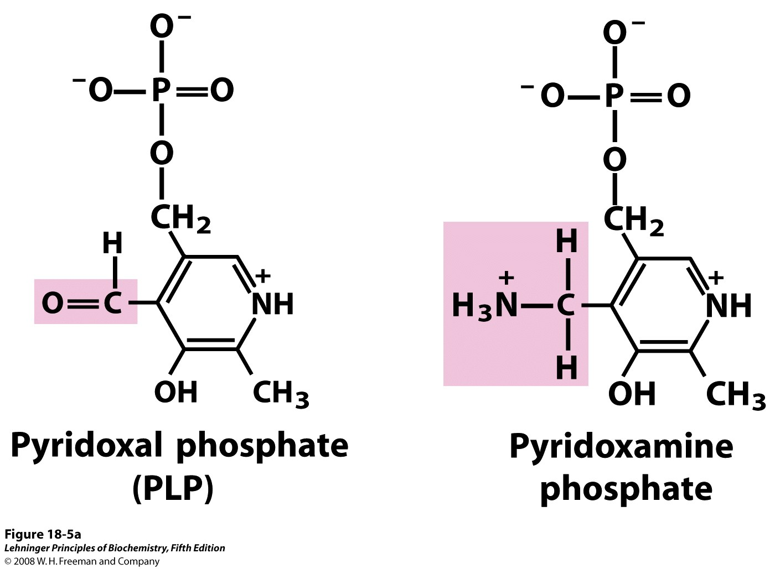
Structure of Pyridoxal Phosphate and Pyridoxamine Phosphate
Intermediate, enzyme-bound carrier of amino groups.
Aldehyde form can react reversibly with amino groups.
Aminated form can react reversibly with carbonyl groups.

Slide 16
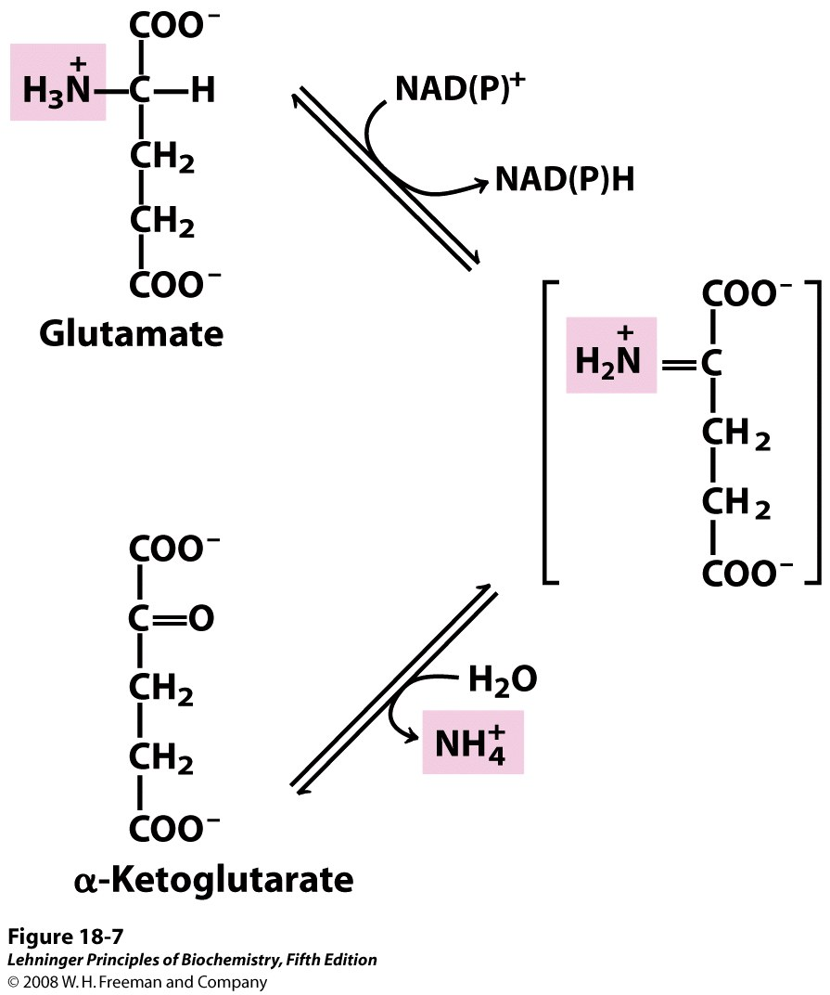
Oxidative deamination
In hepatocytes, glutamate is transported from the cytosol into mitochondria, where it undergoes oxidative deamination catalyzed by L-glutamate Dehydrogenase.
The combined action of an aminotransferase and glutamate dehydrogenase is referred to as transdeamination.
Glutamate dehydrogenase is influenced by an array of allosteric modulators (e.g. ADP is a positive modulator while GTP is a negative modulator).
Mutations that alter the allosteric binding site for GTP lead to a human genetic disorder called hyperinsulinism-hyperammonemia syndrome, characterized by elevated levels of ammonia in the bloodstream and hypoglycemia.

Slide 17
Oxidative deamination
This is an NAD⁺ independent oxidative deamination.
This type of oxidative deamination is catalyzed by amino acid oxidases,Present in the liver and kidney.
They are of two types: D-amino acid oxidase and L-amino acid oxidase, which depend on FAD and FMN respectively.
The reaction mechanism of these oxidases involves first oxidation of aminoacid to iminoacid, followed by hydrolytic loss of ammonia to produce α-keto acid.
Note: The activity of L-amino acid oxidase is low, therefore its contribution to ammonia production minimal.

Slide 18
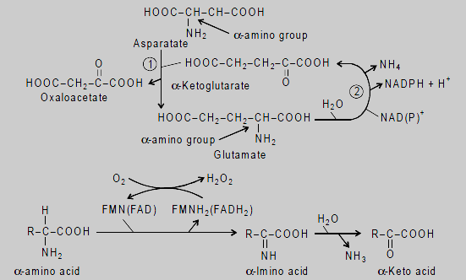
Transdeamination
Oxidative deamination
1
Aspartate amino transferase
Glutamate dehydrogenase
2

Slide 19
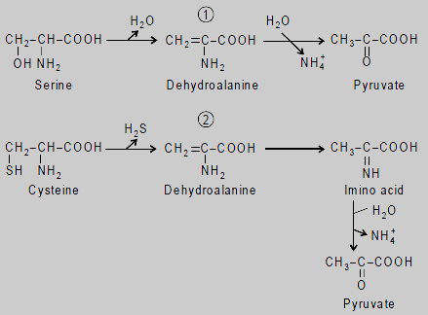
Non-oxidative deamination
Non-oxidative deamination of amino acids is catalyzed by specific enzymes.
1
Serine dehydratase
Cysteine deSulfhydrase
2

Slide 20
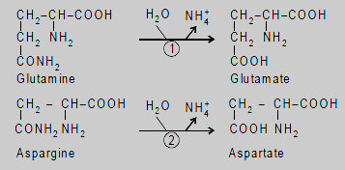
Removal of amide nitrogen of glutamine and aspargine
Specific deamidinases removes amide nitrogen of glutamine and aspargine as ammonia.
They are glutaminase and asparginase,present in the kidney.

Slide 21

Transport of Ammonia
Ammonia produced in the tissues is transported in the form of glutamine and alanine, because free ammonia is toxic even in trace amounts.
Transport of ammonia as glutamine
From the brain and other peripheral organs except muscle ammonia released from amino acids is transported to liver and kidney as amide nitrogen of glutamine.
The enzyme glutamine synthetase catalyzes the formation of glutamine from glutamate and ammonia in an ATP dependent reaction.

Slide 22
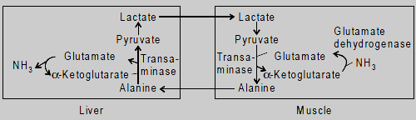
Transport of ammonia as alanine
Since glutamine synthetase activity is low in skeletal muscle ammonia released from deamination of amino acids is transported in the form alanine to liver.

Slide 23
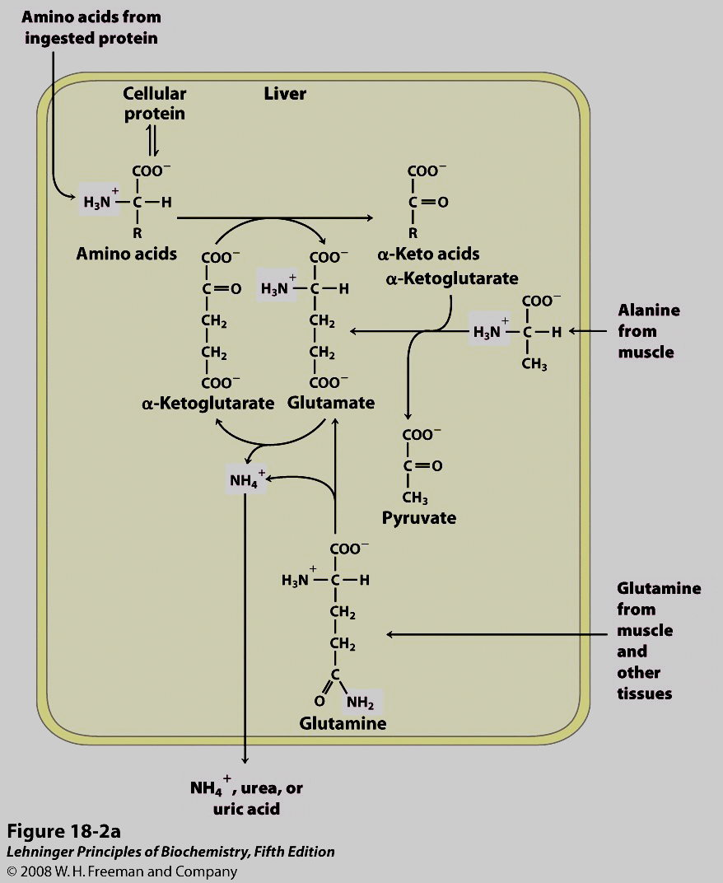
Amino group catabolism.
Under normal conditions liver maintains blood ammonia level within limits by rapidly
converting it into urea.
Thus ammonia produced from glutamine by the
action of glutaminase and deamination of amino acids is converted to urea in the UREA CYCLE.

Slide 24
Urea cycle
The site for urea synthesis is the liver.
The reactions leading to formation of urea from ammonia were proposed by Krebs and Henseleit. Hence, urea cycle is also called as Krebs-Henseleit cycle.
Formation of urea from ammonia in urea cycle occurs in five reactions. However the first reaction is not a part of the cycle but for the continuation of the cycle, the first reaction is essential.
Synthesis of urea from ammonia is an energy dependent process.
Enzymes of urea cycle are present in mitochondria and cytosol.
First two reactions of urea formation occurs in mitochondria while the remaining reactions occur in cytosol.

Slide 25
Reaction Sequence Of Urea Cycle
Formation of carbamoyl phosphate
First reaction leading to urea formation is condensation of ammonia and HCO₃– at the expense of two high-energy bonds to form carbamoyl phosphate.
The reaction is catalyzed by a mitochondrial carbamoyl phosphate synthetase-I.
The enzyme requires N-acetyl glutamate, which is synthesized from acetyl-CoA and glutamate in the liver and Mg2⁺.
2ATP molecules are hydrolyzed to 2 ADP and 2Pi in the first reaction and of the 2Pi one Pi is consumed in the reaction.
Since the product of the reaction carbamoyl phosphate is high energy compound its formation thermodynamically pulls subsequent reactions of urea cycle towards urea formation.

Slide 26
Reactions of urea cycle
The first reaction of urea cycle is catalyzed by ornithine transcarbamoylase. It condenses carbamoyl phosphate and ornithine to form citrulline (this occurs in the mitochondria).
Note: Citrulline is then transported through
specific transporters to the cytosol.
Arginino succinate synthetase present in cytosol catalyzes the condensation of citrulline and aspartate at the expense of two high energy bonds to form argininosuccinate.
In the third reaction of urea cycle argininosuccinate is cleaved by argininosuccinase to arginine and fumarate.
Regeneration of ornithine and formation of urea from arginine is the final reaction of urea cycle. This reaction is catalyzed by arginase.

Slide 27
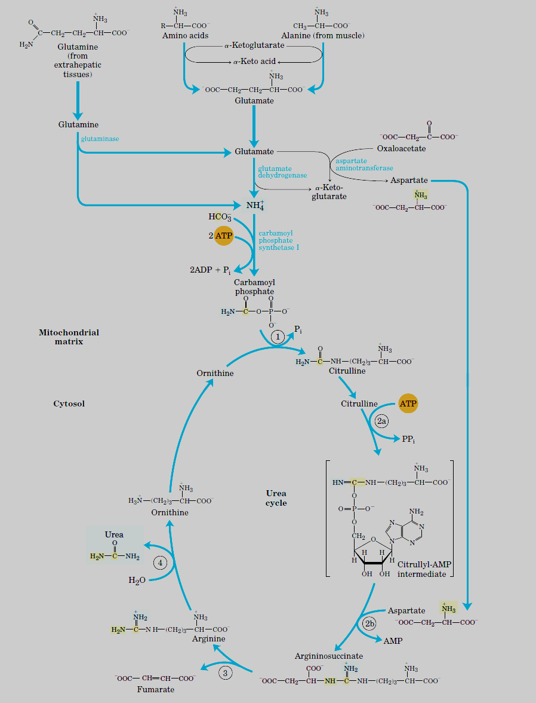
Nitrogen Excretion and the Urea Cycle

Slide 28
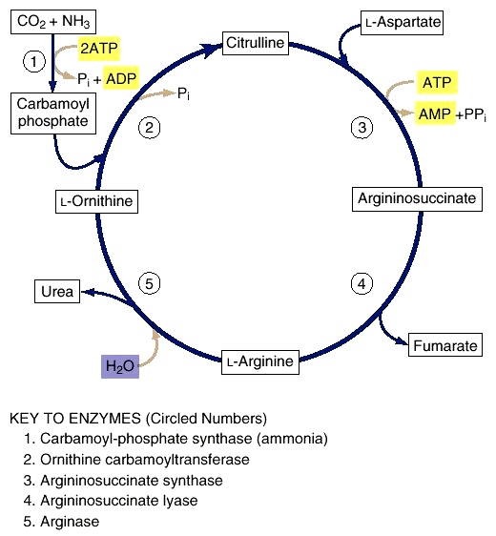
Urea cycle

Slide 29
The Reactions in the Urea Cycle
1 ornithine + carbamoyl phosphate => citrulline
  (entry of the first amino group).
  citrulline passes into the cytosol.
2a citrulline + ATP => citrullyl-AMP + PPi
2b citrullyl-AMP + Aspartate => argininosuccinate + AMP
  (entry of the second amino group).
3 argininosuccinate => arginine + fumarate
  fumarate enters the citric acid cycle.
4 arginine => urea + ornithine
  Ornithine passes to the mitochondria to continue the cycle

Slide 30
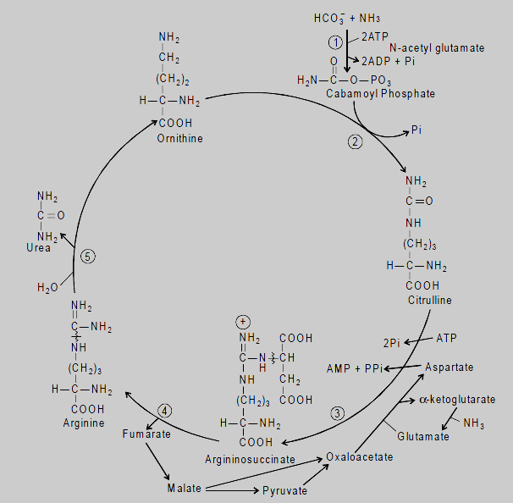
Fate of fumarate from the urea cycle
Fumarate is recycled in urea cycle by converting it to aspartate.

Slide 31
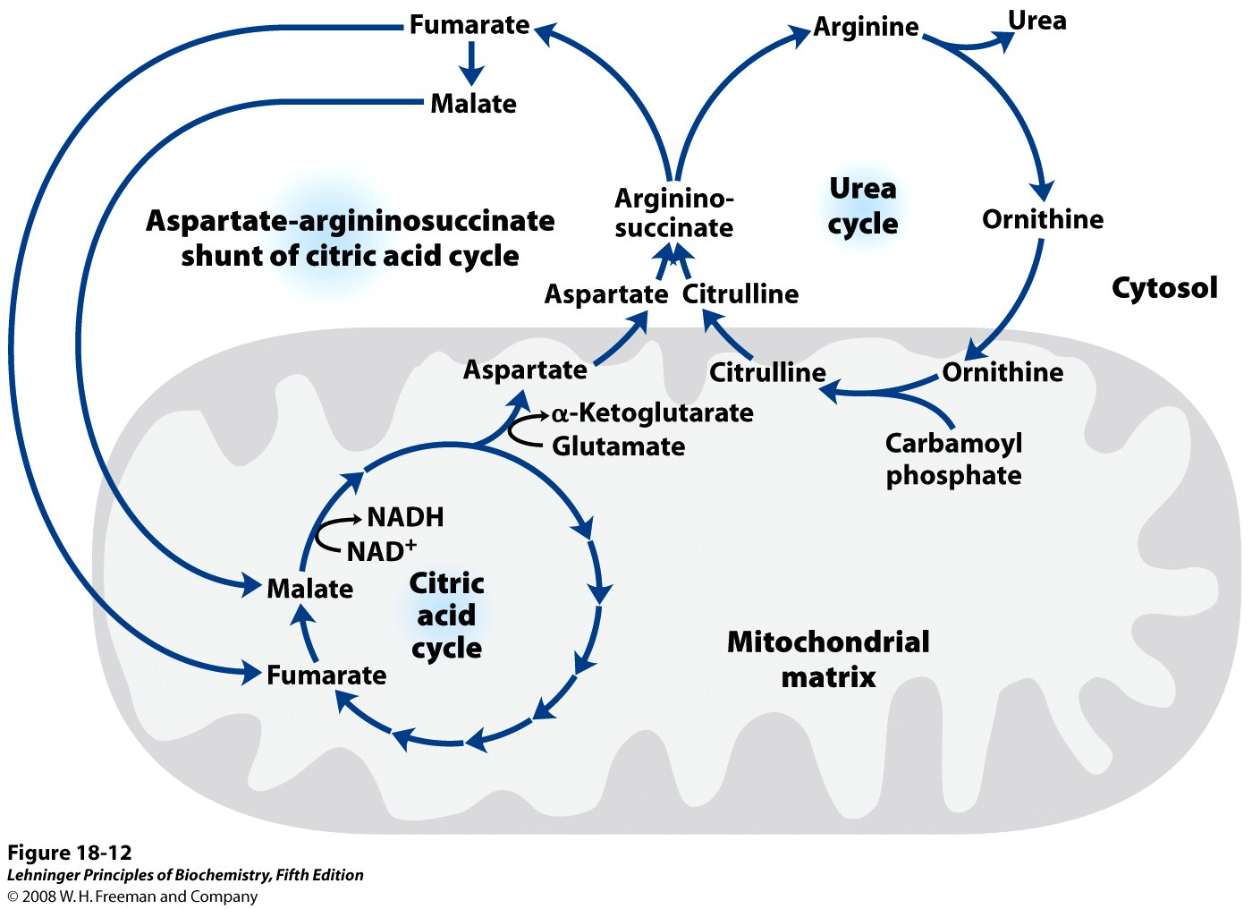
Aspartate –Arginosuccinate Shunt Links Urea Cycle and Citric Acid Cycle

Slide 32
Regulation of urea formation
Formation of urea is regulated by activity of carbamoyl phosphate synthetase-I. This enzyme catalyzes committed step in urea synthesis.
N-acetylglutamate is an allosteric activator of the enzyme.
High protein in take leads to high levels of N-acetylglutamate formation.Thus high protein in take influences urea formation.
In starvation the rate of urea synthesis is also high due to increased protein breakdown.

Slide 33
Diseases of the urea cycle
Urea formation is impaired in several inherited diseases due to deficiency of enzymes of urea cycle.
Since the urea cycle converts ammonia to urea these disorders may cause ammonia intoxication.
Some common clinical symptoms seen in these diseases are vomiting, irritability, lethargy, seizures, mental retardation, coma and early death.

Slide 34
Hyper ammonemia Type I
It is due to deficiency of enzyme carbamoyl phosphate synthetase-I.
Mental retardation is the main symptom of this condition.
Hyper ammonemia Type II
It is most common among others. It is due to deficiency of enzyme ornithine trans carbamoylase.
In this condition carbamoyl phosphate accumulates and diverted to pyrimidine formation resulting to excretion of oroticacid and uracil in urine.
Glutamate also accumulates in this condition.
Citrullinemia
This condition is due to the absence of enzyme argininosuccinate synthetase. Hence citrulline accumulates in blood and excreted in urine.
Argininosuccinicaciduria
Argininosuccinase is absent in this condition. So, argininosuccinate accumulates in blood and excreted in urine.
Hyper argininemia
This condition is due to low arginase activity. Hence, arginine accumulates and excreted in urine. However some urea may be excreted in urine due to kidney arginase.

Slide 35
Treatment
Treatment of urea cycle disorders involves removal of excess ammonia from blood and reduction of dietary nitrogen load.
Peritonial dialysis is employed to clear ammonia from blood.
Administration of compounds which can increase nitrogen excretion is another line of treatment.
Benzoic acid and phenyl acetate are two such compounds used in the treatment.

Slide 36
Fates of Nitrogen in Organisms
Plants conserve almost all the nitrogen
Many aquatic vertebrates release ammonia to their environment thro;
  passive diffusion from epithelial cells
  active transport via gills
Many terrestrial vertebrates and sharks excrete nitrogen in the form of urea
  Urea is far less toxic than ammonia
  Urea has very high solubility
Some animals, such as birds and reptiles excrete nitrogen as uric acid
  Uric acid is rather insoluble
  Excretion as paste allows to conserve water

Slide 37
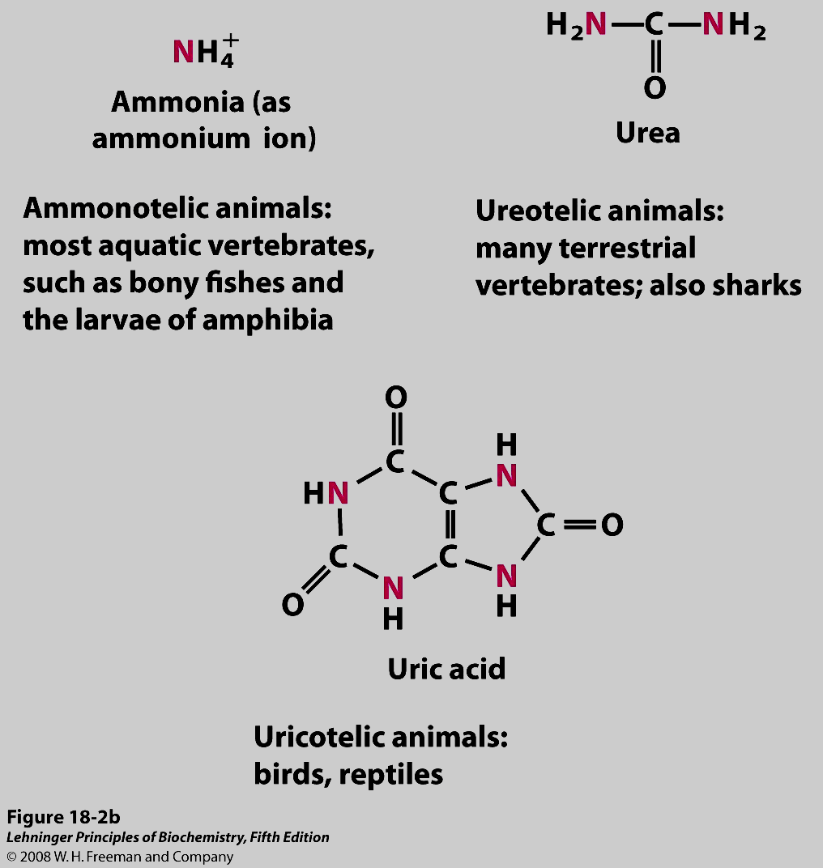
Excretory Forms of Nitrogen

Slide 38
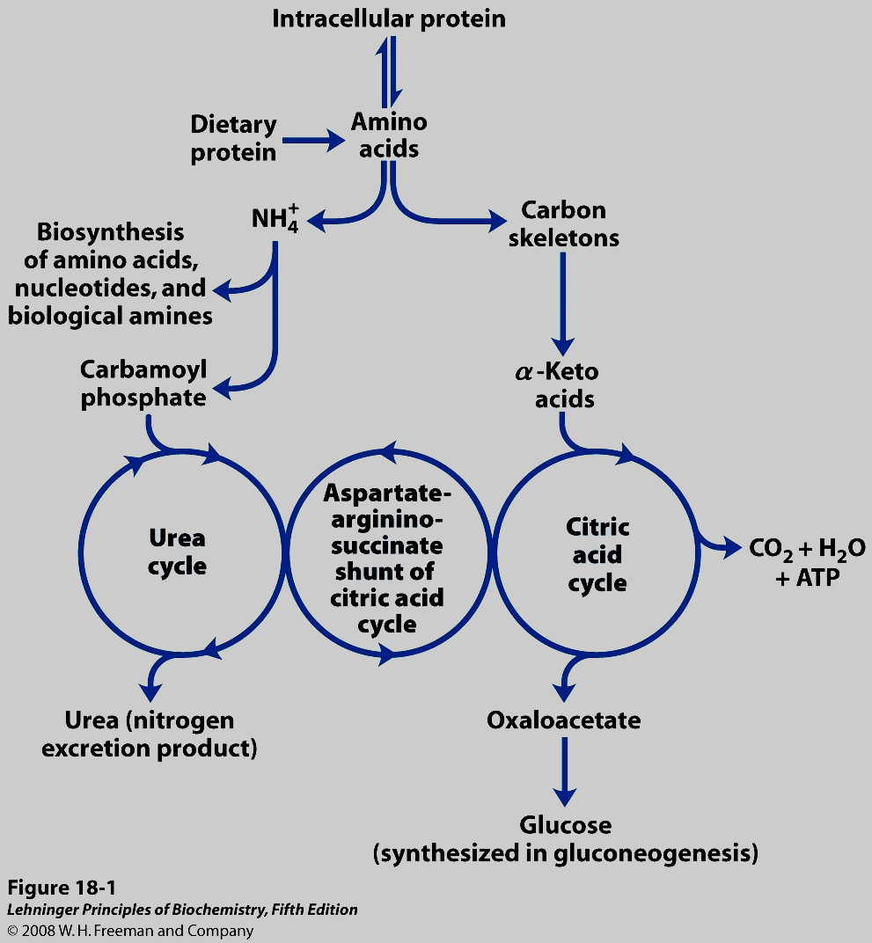
Overview of Amino Acid Catabolism

Slide 39
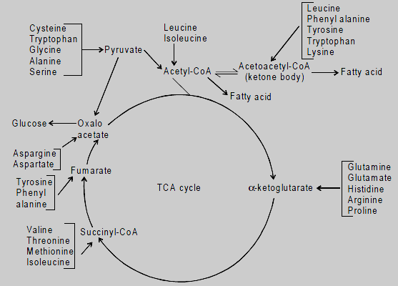
Metabolic fates of carbon skeletons of Amino acids
Initial deamination of aminoacids produces carbon skeletons of amino acids.
The carbon skeletons of twenty aminoacids are converted to seven compounds.
These seven compounds are ultimately used for the formation of carbohydrates or fat like substances.

Slide 40
Amino acids also are classified based on the metabolic fate of their carbon skeletons.
Glucogenic amino acids
The carbon skeletons of these aminoacids are converted to either glucose or intermediates of TCA cycle.
The products may be pyruvate, oxaloacetate, α-ketoglutarate, succinate and fumarate.
Glycine, alanine, valine, serine, threonine, cysteine, methionine, aspartate (aspargine), glutamate (glutamine), histidine, arginine and proline are glucogenic amino acids.
Note: all non-essential amino acids are glucogenic.

Slide 41
Ketogenic amino acids
The carbon skeletons of these aminoacids gives rise to fat like substances or intermediates of fatty acid catabolism.
The products may be aceto acetyl-CoA and acetyl-CoA. Leucine is the only ketogenic aminoacid.
Isoleucine, phenylalanine, tyrosine, tryptophan and lysine are also ketogenic amino acids.
Glucogenic and ketogenic amino acids
The carbon skeletons of these amino acids are converted to glucose or intermediates of TCA cycle and fat like substance.
The products may be pyruvate, succinate, fumarate and acetyl-CoA.
Isoleucine, phenylalanine, tyrosine, tryptophan and lysine are glucogenic and ketogenic

Slide 42
Fate of Individual Amino Acids
Seven to acetyl-CoA
  Leu, Ile, Thr, Lys, Phe, Tyr, Trp
Six to pyruvate
  Ala, Cys, Gly, Ser, Thr, Trp
Five to α-ketoglutarate
  Arg, Glu, Gln, His, Pro
Four to succinyl-CoA
  Ile, Met, Thr, Val
Two to fumarate
  Phe, Tyr
Two to oxaloacetate
  Asp, Asn

Slide 43
Six Amino Acids Are Degraded to Pyruvate
The carbon skeletons of six amino acids are converted in whole or in part to pyruvate.
The pyruvate can then be converted to either acetyl-CoA (a ketone body precursor) or oxaloacetate (a precursor for gluconeogenesis). Thus amino acids catabolized to pyruvate are both ketogenic and glucogenic.
The six are alanine, tryptophan, cysteine, serine, glycine, and threonine.

Slide 44
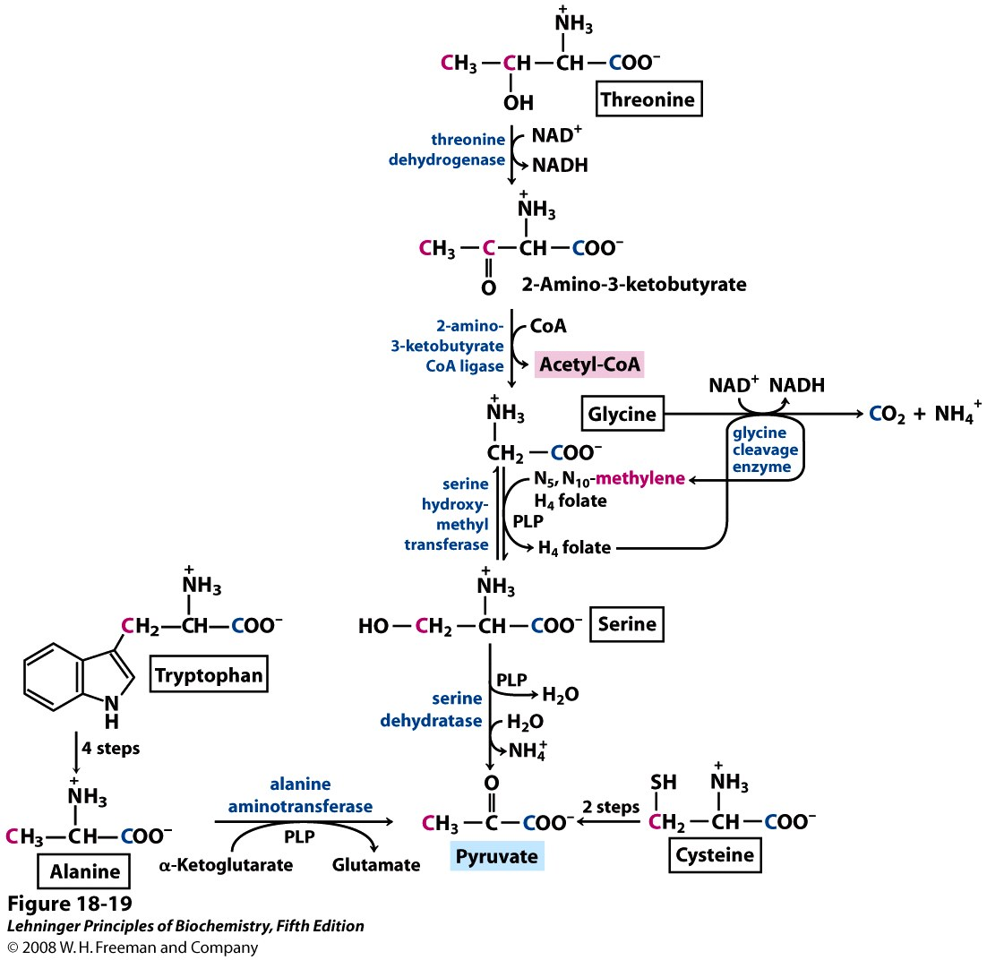
6 Amino Acids -> PyruvatAla, Gly, Ser, Cys,Trp,Thr.

Slide 45
Seven Amino Acids Are Degraded to Acetyl-CoA
Portions of the carbon skeletons of seven amino acids—tryptophan, lysine, phenylalanine, tyrosine, leucine,isoleucine, and threonine—yield acetyl-CoA and/or acetoacetyl-CoA, the latter being converted to acetyl-CoA.
Some of the intermediates in tryptophan catabolism are precursors for the synthesis of other biomolecules, including nicotinate, a precursor of NAD and NADP in animals; serotonin, (a neurotransmitter in vertebrates) and indoleacetate (a growth factor in plants).
The breakdown of phenylalanine is noteworthy because genetic defects in the enzymes of this pathway lead to several inheritable human diseases.
After its hydroxylation to tyrosine, phenylalanine is also the precursor of dopamine (a neurotransmitter) and of norepinephrine and epinephrine(hormones secreted by the adrenal medulla).
Melanin, the black pigment of skin and hair, is also derived from tyrosine.

Slide 46
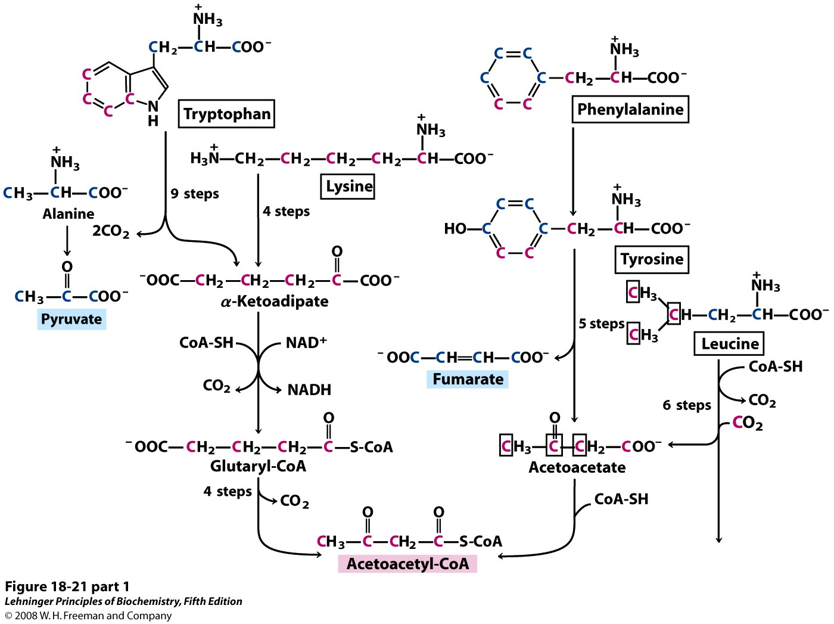
7 AAs -> Acetyl CoA

Slide 47
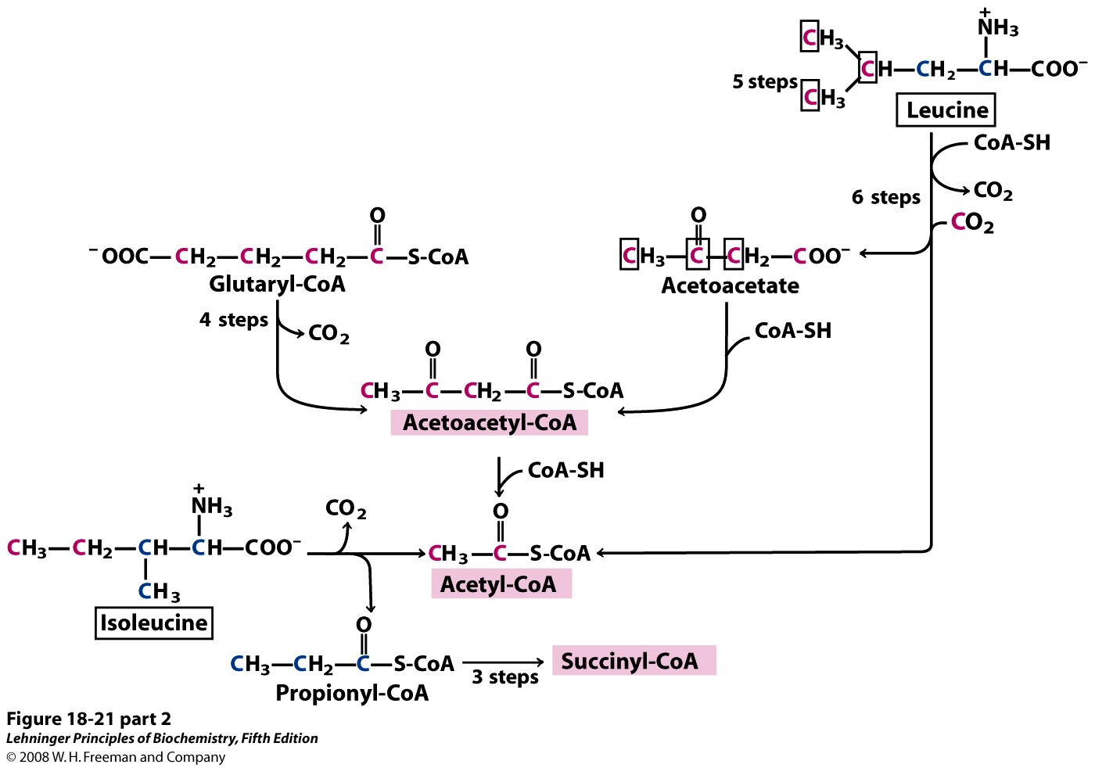

Slide 48
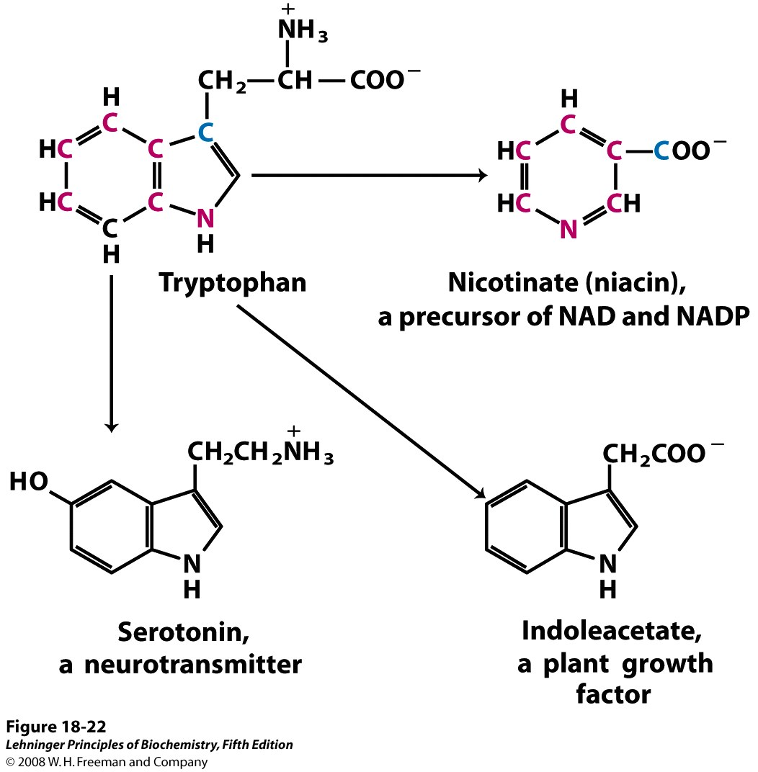
Indole Ring Recycling

Slide 49
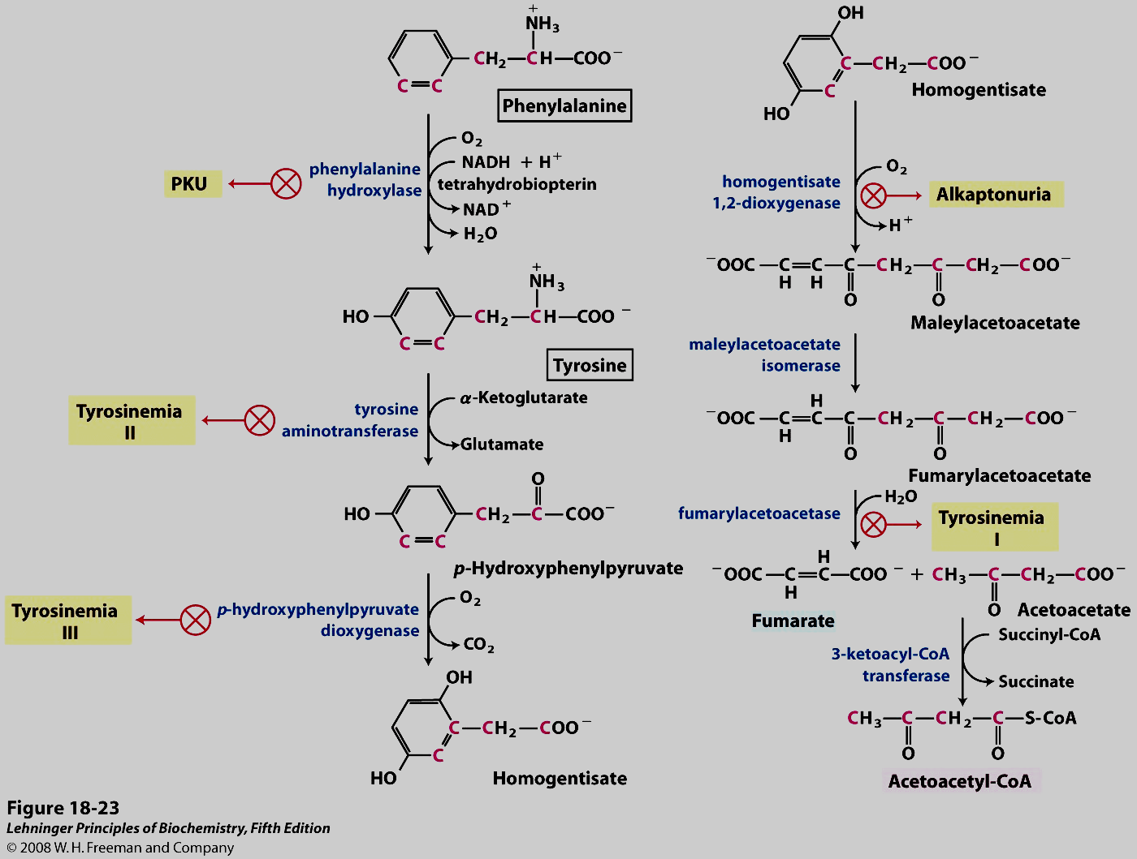
Metabolic Diseases – Defects of Aromatic AA degradation

Slide 50
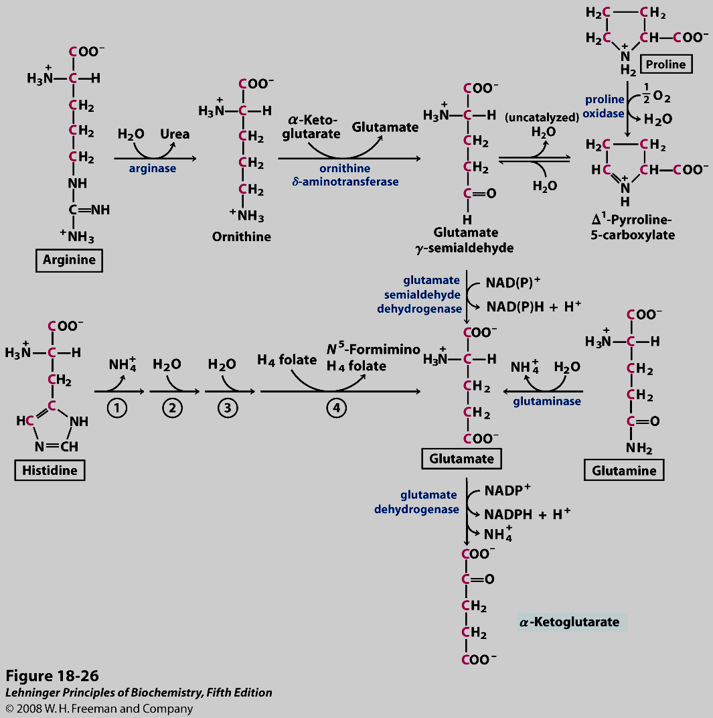
Amino acids -> α- ketoglutarate

Slide 51
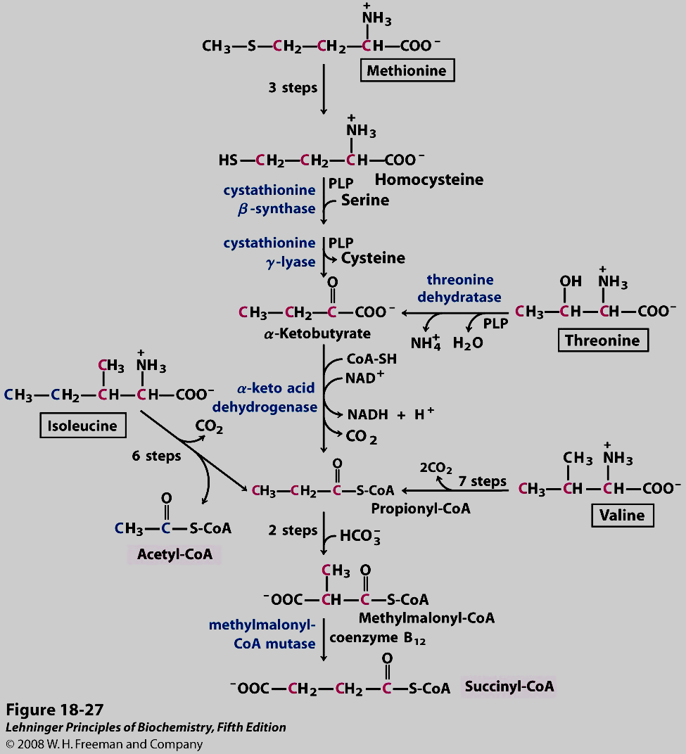
Amino acids-> Succinyl-CoA

Slide 52
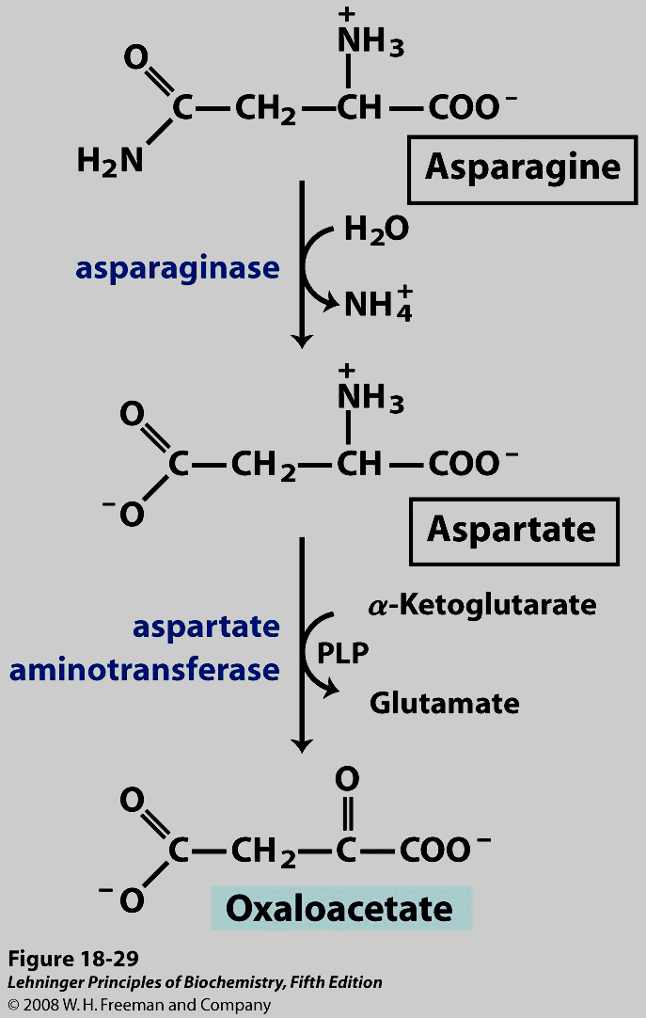
Asp and Asn to oxaloacetate.

Slide 53
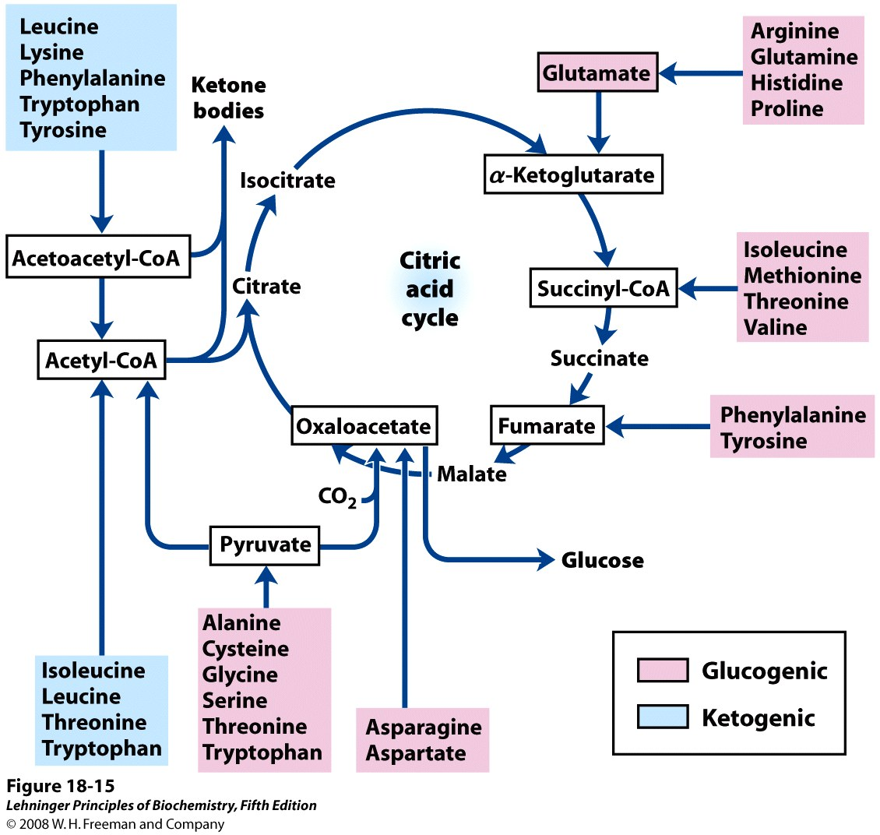
Summary of Amino Acid Catabolism

